Slide 1
Updated Understanding of MAJIQ output
Jun 14, 2023
Group Meeting
Zhen Gao

Slide 2
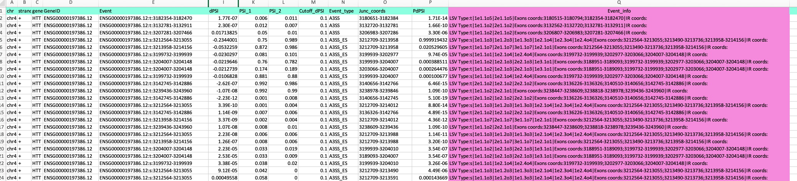
Sample Output

Slide 3
Sample Output:event_info
LSV Type:t|1e1.1o5|2e1.1o5|Exons coords:3180515-3180794;3182354-3182470|IR coords:
LSV Type:t|1e1.1o2|2e1.1o2|Exons coords:3132562-3132720;3132781-3132911|IR coords:
LSV Type:t|1e1.1o2|2e1.1o2|Exons coords:3206807-3206983;3207281-3207466|IR coords:
LSV Type:s|1e1.1o3|1e1.2o3|1e1.3o3|1e2.1o4|1e2.3o4|1e2.4o4|Exons coords:3212564-3213055;3213490-3213736;3213958-3214156|IR coords:
LSV Type:t|1e1.1o7|2e1.1o7|3e1.1o7|1e2.1o1|Exons coords:3212564-3213055;3213490-3213736;3213958-3214156|IR coords:
LSV Type:s|1e1.1o1|1e2.1o4|1e2.4o4|Exons coords:3199732-3199939;3202977-3203066;3204007-3204148|IR coords:
LSV Type:t|1e1.1o2|1e2.1o3|2e2.1o3|1e3.1o1|Exons coords:3188951-3189093;3199732-3199939;3202977-3203066;3204007-3204148|IR coords:
LSV Type:t|1e1.1o2|1e2.1o3|2e2.1o3|1e3.1o1|Exons coords:3188951-3189093;3199732-3199939;3202977-3203066;3204007-3204148|IR coords:
LSV Type:s|1e1.1o1|1e2.1o4|1e2.4o4|Exons coords:3199732-3199939;3202977-3203066;3204007-3204148|IR coords:
LSV Type:t|2e1.1o2|1e2.1o2|2e2.1o2|Exons coords:3136226-3136326;3140510-3140656;3142745-3142886|IR coords:
LSV Type:t|1e1.1o2|2e2.1o1|Exons coords:3238447-3238609;3238818-3238978;3239436-3243960|IR coords:
LSV Type:t|2e1.1o2|1e2.1o2|2e2.1o2|Exons coords:3136226-3136326;3140510-3140656;3142745-3142886|IR coords:
LSV Type:s|1e1.1o3|1e1.2o3|1e1.3o3|1e2.1o4|1e2.3o4|1e2.4o4|Exons coords:3212564-3213055;3213490-3213736;3213958-3214156|IR coords:
LSV Type:t|2e1.1o2|1e2.1o2|2e2.1o2|Exons coords:3136226-3136326;3140510-3140656;3142745-3142886|IR coords:
LSV Type:t|1e1.1o7|2e1.1o7|3e1.1o7|1e2.1o1|Exons coords:3212564-3213055;3213490-3213736;3213958-3214156|IR coords:
LSV Type:t|1e1.1o2|2e2.1o1|Exons coords:3238447-3238609;3238818-3238978;3239436-3243960|IR coords:
LSV Type:s|1e1.1o3|1e1.2o3|1e1.3o3|1e2.1o4|1e2.3o4|1e2.4o4|Exons coords:3212564-3213055;3213490-3213736;3213958-3214156|IR coords:

Slide 4

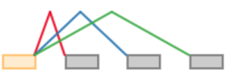
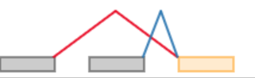
The central idea of MAJIQ: local splicing variations
(0) s|1e1.1o1|1e2.1o1|1e3.1o1
(1) t|1e1.1o1|1e2.1o1

Slide 5
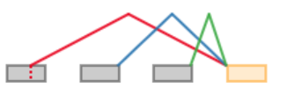
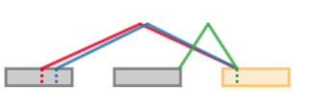
The central idea of MAJIQ: local splicing variations
(5) t|1e1.1o2|1e2.1o1|1e3.1o1
(9) t|2e1.1o3|2e1.2o3|2e2.1o1

Slide 6
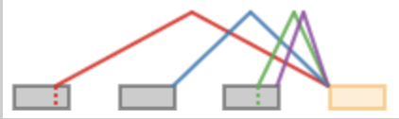

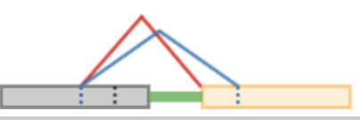
The central idea of MAJIQ: local splicing variations
(16) t|1e1.2o3|1e2.1o1|1e3.1o2|1e3.2o2
(135) s|1e1.1o1|i
(1572) t|1e1.1o3|2e1.1o3|i
t|2e1.1o1|3e1.1o1|3e2.1o2

Slide 7
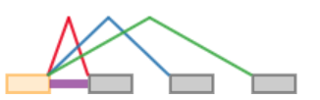
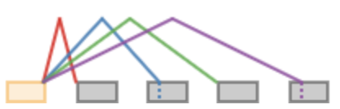
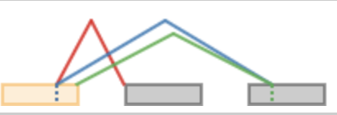
The central idea of MAJIQ: local splicing variations
(2) s|1e1.1o1|1e2.1o1|1e3.1o1|i
(13) s|1e1.1o1|1e2.2o2|1e3.1o1|1e4.2o2
(22) s|1e1.1o1|1e2.2o2|2e2.2o2

Slide 8
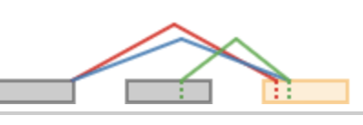
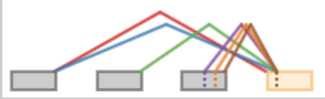
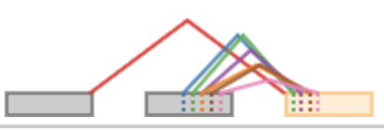
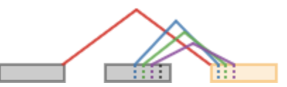
The central idea of MAJIQ: local splicing variations
(1573) t|2e1.1o1|3e1.1o1|3e2.1o2
(1638) t|1e1.1o1|2e1.1o1|2e2.1o1|2e3.1o3|2e3.2o3|2e3.3o3
(1645) t|1e1.1o1|2e2.1o6|2e2.2o6|3e2.3o6|4e2.3o6|4e2.4o6|5e2.5o6
(1779) t|1e1.1o1|2e2.1o5|3e2.2o5|4e2.3o5

Slide 9
The central idea of MAJIQ: local splicing variations
chr4 + HTT ENSG00000197386.12:s:3212564-3213055
LSV Type:s|1e1.1o3|1e1.2o3|1e1.3o3|1e2.1o4|1e2.3o4|1e2.4o4|
Exons coords:3212564-3213055;
3213490-3213736;
3213958-3214156
chr4 + HTT ENSG00000197386.12:t:3130305-3130423
LSV Type:t|1e1.1o4|1e1.2o4|1e1.3o4|i|
Exons coords:3128339-3130062;
3130063-3130304; 3130305-3130423|IR coords:3130063-3130304

Slide 10
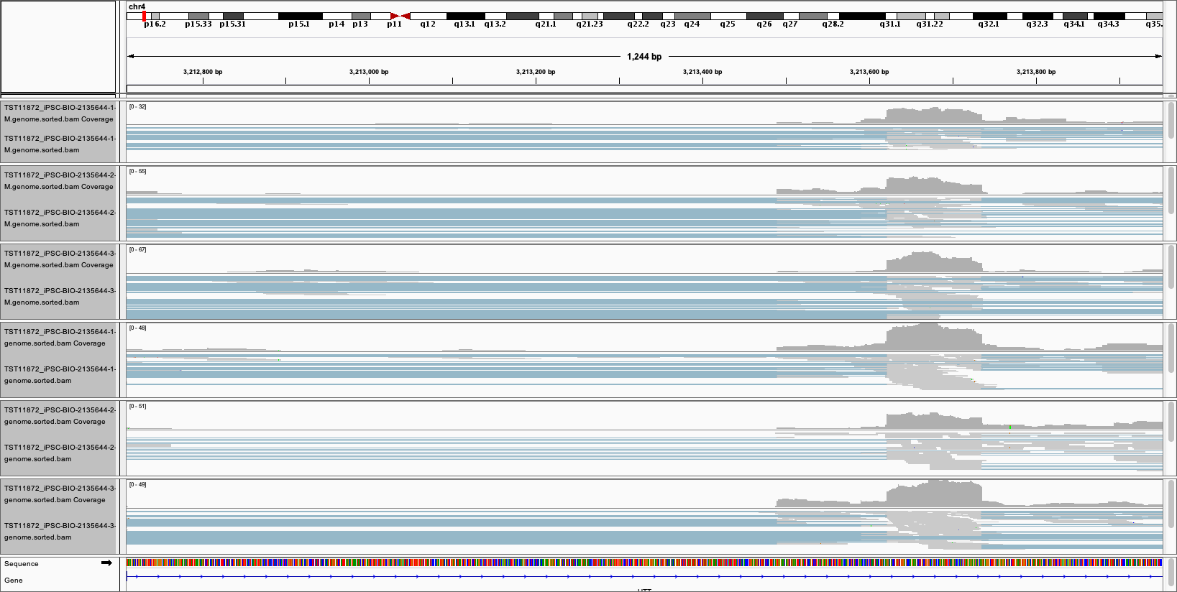
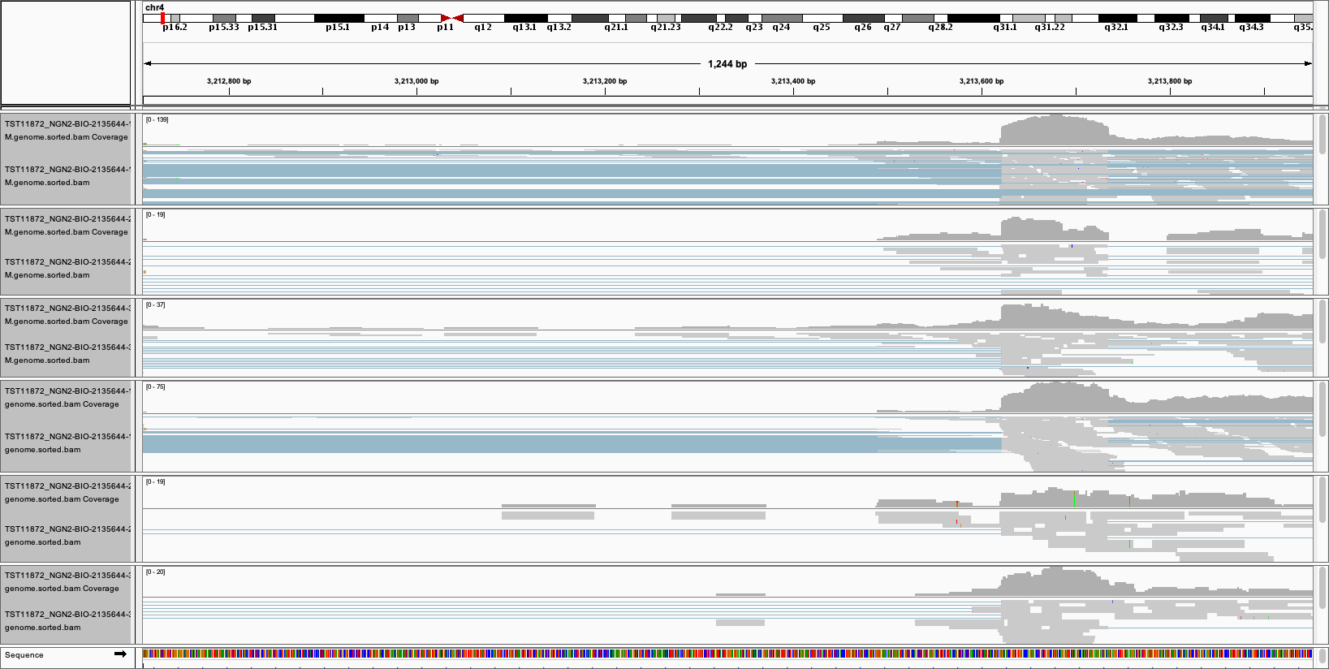
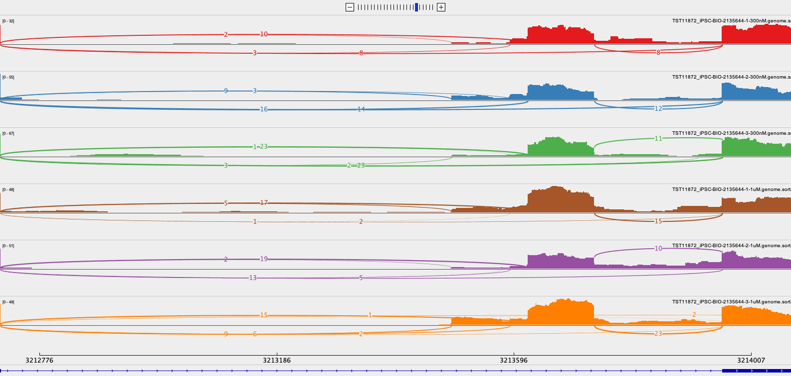
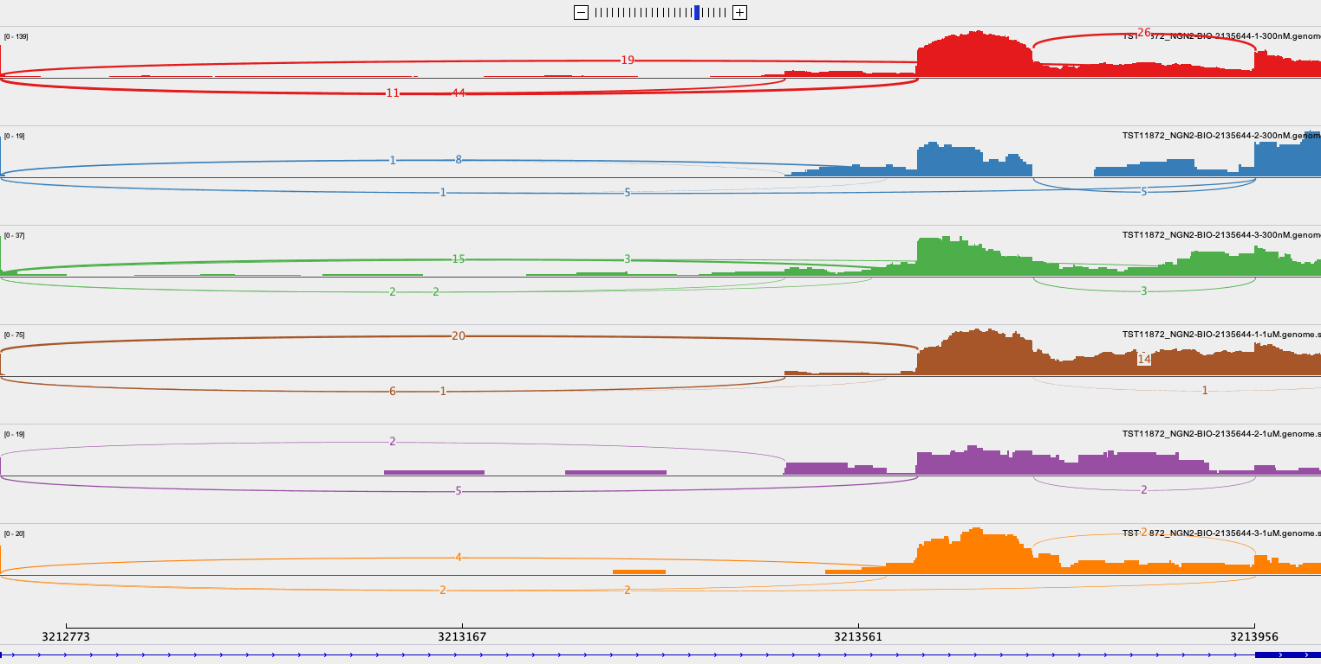
2135644 in iPSC and NGN2

Slide 11
2136770 (1000nM) in iPSC(Left) and NGN2(Right)

Slide 12
It looks more than toxic exon spicing in
Classical toxic exon splicing in type
48
49
49N
50
51
Ex49N: chr4:3,213,622-3,213,736 (+)
Non-Classical but high frequent ones
48
49
49N
Intron
50
51
Non-Classical and less frequent ones
48
49
49N
Intron
50
51
Nonsense-mediated mRNA decay (NMD)
Edited from Jessica Plots

Slide 13
The central idea of MAJIQ: local splicing variations

